Slide 1
Chapter 2 Configuration Space
Chapter 3 Rigid-Body Motions
3.2 Rotations and Angular Velocities
3.3 Rigid-Body Motions and Twists
3.4 Wrenches
Chapter 4 Forward Kinematics
Chapter 5 Velocity Kinematics and Statics
Chapter 6 Inverse Kinematics
Chapter 7 Kinematics of Closed Chains
Chapter 8 Dynamics of Open Chains
Chapter 9 Trajectory Generation
Chapter 10 Motion Planning
Chapter 11 Robot Control
Chapter 12 Grasping and Manipulation
Chapter 13 Wheeled Mobile Robots

Slide 2
Important concepts, symbols, and equations
A configuration can be represented by exponential coordinates S𝜃 ∈ ℝ⁶: a screw axis S multiplied by the distance 𝜃 it is followed. (Equivalently, Vt: a twist V and a time t it is followed.)
As with rotations, we can define a matrix exponential and its inverse, the matrix log. The exponential “integrates a twist” for time 1, and the log finds the constant twist needed to achieve the displacement in time 1.

Slide 3
Important concepts, symbols, and equations
For S = (𝜔, v) , either
||𝜔|| = 1:
or 𝜔 = 0 and ||v|| = 1:

Slide 4
Important concepts, symbols, and equations (cont.)
A wrench is F = (m, f ) ∈ ℝ⁶. A linear force f ∈ ℝ³ at r creates a moment m = r × f.
The dot product of a wrench and a twist is power: P = V^{T} F.
The same wrench can be expressed in {a} and {b} as F_{a} and F_{b}.
Changing the frame of representation (power better be independent of the frame we use to represent twists and wrenches!):

Slide 9
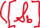



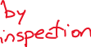
What is the screw S_{a}? S_{b}?
If {b} follows the screw a distance 𝜃,
what is the mathematical expression
for the final configuration T_{ab’}?
If 𝜃 = 𝜋, give the numerical entries of T_{ab’}.
A screw axis is defined by the screw
image (positive motion drives the screw
upward), and the pitch is 5 mm/rad.
The origin of {b} is at (0,4,−2) mm in {a}.
What is T_{ab}?

Slide 10
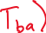

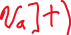



Given frames {a}, {b}, and {c}, and their representations relative to each
other T_{ab} and T_{ac}, write the twist needed to move {b} to {c} in t seconds
in the se(3) form [V_{a}].

Slide 11


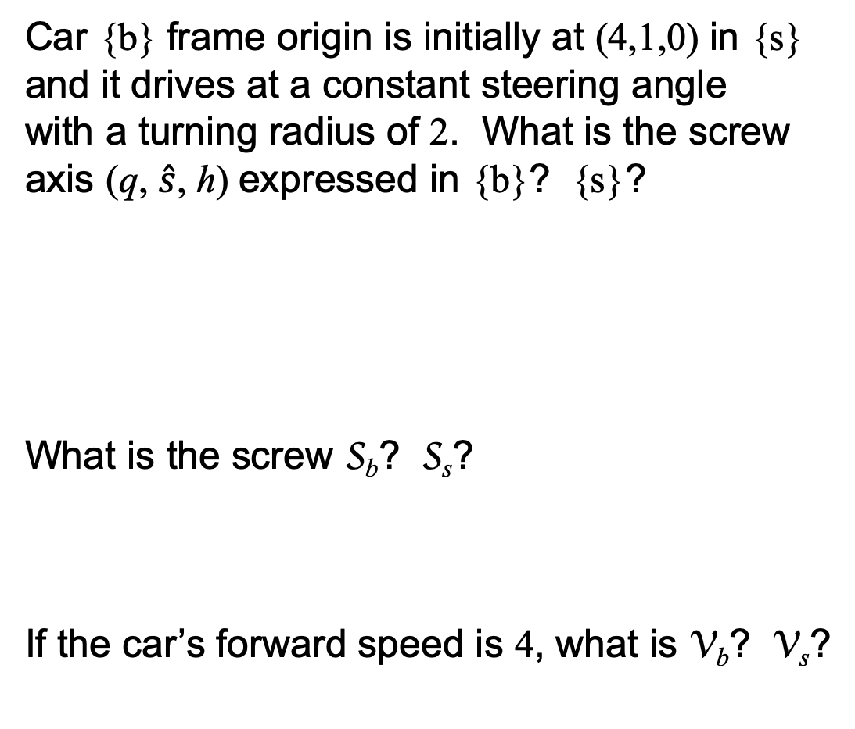
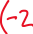
Car {b} frame origin is initially at (4,1,0) in {s}
and it drives at a constant steering angle
with a turning radius of 2. What is the screw
axis (q, $\hat{s}$, h) expressed in {b}? {s}?
What is the screw S_{b}? S_{s}?
If the car’s forward speed is 4, what is V_{b}? V_{s}?

Slide 12


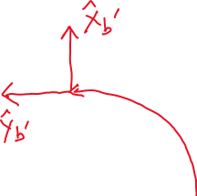


If the car completes a quarter of a rotation,
what are the exponential coordinates S_{b}𝜃? S_{s}𝜃?
Where does the car end up? Draw a picture.
Express this final configuration mathematically,
in terms of T_{sb} (as shown in the figure) and (1) the
matrix exponential of [S_{b}𝜃] or (2) the matrix
exponential of [S_{s}𝜃].

Slide 13
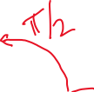
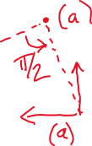
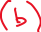
Draw the {b’} frame if
T_{sb’} = T_{sb} exp([S_{s}𝜃]).
Draw the {b’} frame if
T_{sb’} = exp([S_{b}𝜃]) T_{sb}.

Slide 14

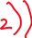

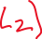
If gravity acting on the apple causes a downward force of 3 N, what is the
wrench F_{f} felt at the force-torque sensor due to the apple?

